Slide 1
New Benefit: Wellthy

Slide 2

Background
the best care for our patients, starts with the best care for yourself.
Balancing career, family, and personal life can be challenging, especially if you’re caring for a loved one’s well-being in addition to your own. In an effort to alleviate employees, we’re providing you and your families with access to Wellthy, a caregiving support solution, as a covered benefit.

Slide 3


Penn Medicine + Wellthy
What is Wellthy?
Wellthy’s care solution pairs a suite of digital tools in the Care Dashboard with human-touch support from a Wellthy Care Coordinator who will take on administrative and logistical tasks on your family’s behalf. It also includes Wellthy Community – a peer-to-peer space for family caregivers to connect and exchange knowledge.
Who can Wellthy support?
This benefit applies to all Benefit Eligible Employees
Wellthy is available to help you care for yourself, or any of your loved ones. This means parents, children, spouses, in-laws, siblings, neighbors, or anyone whose care needs are impacting your day-to-day life.

Slide 4
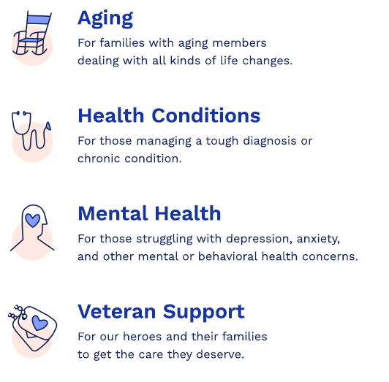

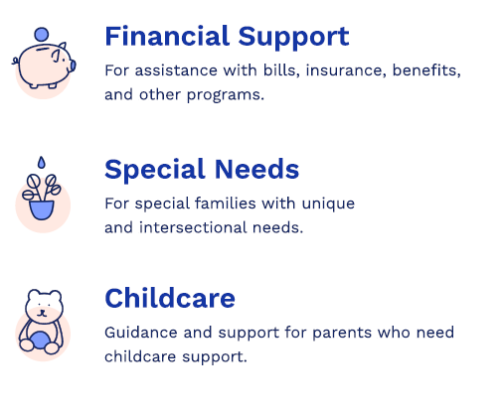
What can Wellthy help with?
Whether it’s care for yourself, your spouse, your children, your parents, or a member of your chosen family, Wellthy is here to help.

Slide 5



How can Wellthy help?
If you’re in the planning stage or don’t have immediate care needs, create an account so it’s there for when you need it and familiarize yourself with the Care Dashboard’s digital tools.
If you’re in the midst of a care situation, start a Care Project to get matched with a Care Coordinator. This expert will get to know your needs, map out priorities, and handle those tricky and time-consuming tasks related to care (think: researching providers, scheduling appointments, appealing medical bills, vetting aides).
If you’ve acted as a caregiver in the past or present for a loved one or yourself, join Wellthy Community to connect with others in similar situations.

Slide 6
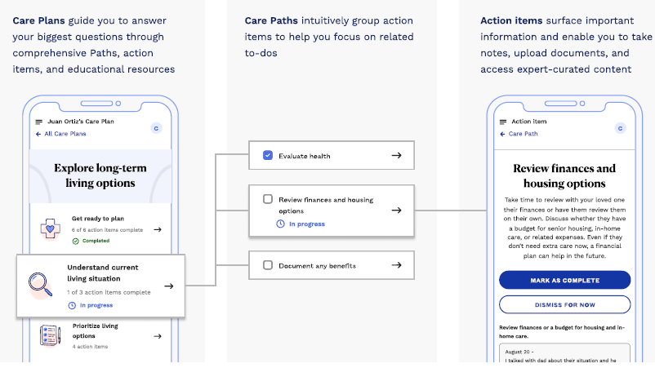
Care Planning Journey

Slide 7



Benefits of Care Support from Wellthy
A skilled care professional dedicated to you
Your Care Coordinator will get to know your care story beginning to end. They'll identify priorities, design a personalized plan, tackle administrative tasks, and act as an advocate on your behalf.
Help with immediate needs, or support for the long run
Create your account and open a Care Project to begin getting dedicated help now, or start by using the digital tools within the Care Dashboard so everything is set up for when you need it .
A community of caregivers who can relate to what you're going through
Wellthy Community is a peer-to-peer space for family caregivers to find support, share experiences, and exchange knowledge across a range of care topics.
Guidance from experts who know the care industry
Wellthy Care Coordinators are backed by specialized teams who are experts across every variable of care - from insurance to in-home care to mental health and beyond.
Family meetings, simplified
Keep siblings, relatives, neighbors, and anyone involved in care situation in the loop with streamlined communication - one email thread, one central channel, one voice of reason.
Everything you need, all in one place
The Care Dashboard keeps your information safe and accessible . Maintain all of your contacts, keep up with doctor appointments, track tasks, and store important documents.

Slide 8

Testimonials
“Wellthy has been an invaluable resource for my family
as we try to care for our aging father and carry on our
own lives. From chasing down prescription information,
to finding an Elder Care attorney, to simply listening and
helping us cope, we have benefited greatly from
Wellthy's caring experts.”
“
“Wellthy has been an invaluable benefit for my family. Having a Care Coordinator in the midst of my husband's medical emergency was vital for all our mental health and getting him home from the hospital quickly and safely. We were able to stay with the same care coordinator throughout rehab, follow ups and then resolution with the billing process as well. An expected couple of weeks of support turned into over a year of compassionate, professional service. Thank you!”
”

Slide 9

How to get started with Wellthy
01
Create an account
Visit join.wellthy.com/uphs and click 'GET STARTED.' Enter your Penn Medicine SSO credentials to create your account
Follow the steps below to create your account, connect with a Care Coordinator, or begin using the self-service tools within the Care Dashboard.
Whether you're planning for caregiving responsibilities, navigating the aftermath of a sudden event or new diagnosis, managing an ongoing condition, or simply want to connect with others who are caring, Wellthy's suite of offerings meet you wherever you are in your caregiving journey.
02
Confirm your eligibility
To verify you have sponsored access to Wellthy's services as a covered benefit, you will need to confirm your eligibility during the onboarding process
03
Start a Care Project or explore Wellthy Community
We'll ask for a bit of information on who you're caring for so we can match you with the best-fit expert on our team. As a final step, let us know if you're ready to start working with a Care Coordinator, or simply choose your Wellthy Community display name to connect with other family caregivers

Slide 10
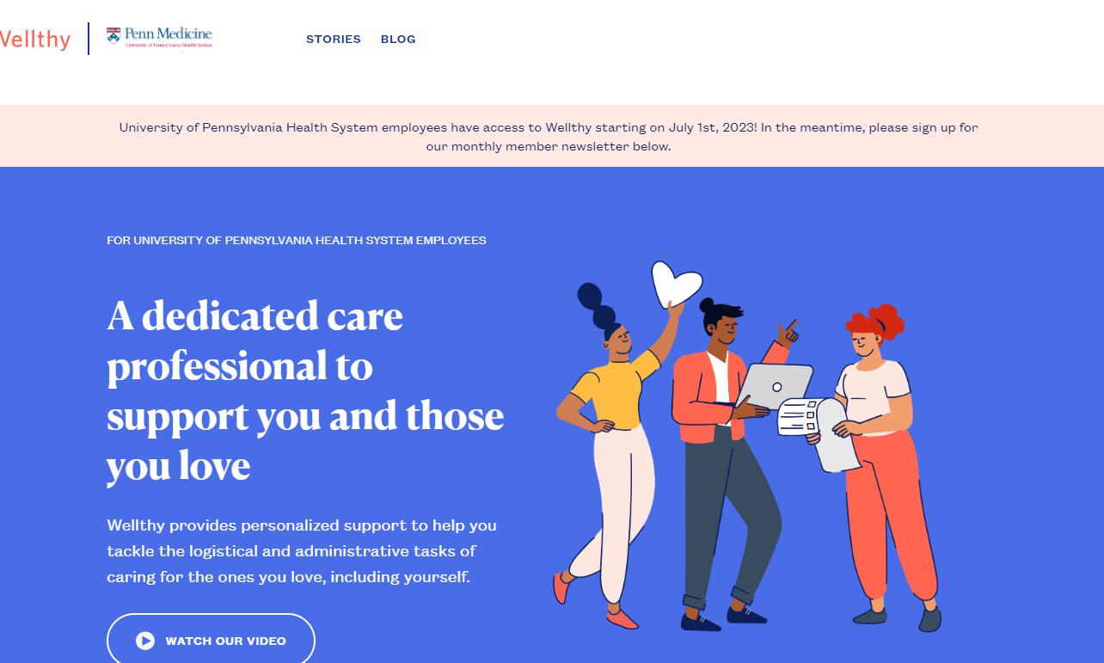
Contact
join.wellthy.com/uphs
WorkLife@pennmedicine.upenn.edu
Coming Soon: Benefit Spotlights:
July 14- 12:00pm
July 27- 9:00am

